Slide 1
English 2 July 14
Max Keenan

Slide 2
Attendance
If you had to be born in any country other than China, what country would you pick? Why?

Slide 3
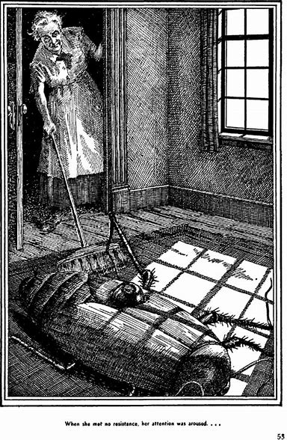
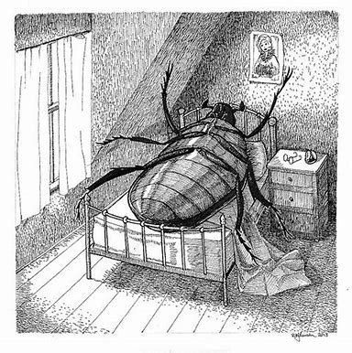
The Metamorphosis

Slide 4
Why doesn't Gregor drink the milk his sister leaves for him?
Gregor finds it hard to eat anything with the soreness and tenderness in his side, and the sight of the milk only repulses him, even though it has always been his favorite drink.

Slide 5
Why does the household cook ask Mrs. Samsa to let her go?
The cook wants to leave the Samsa household because she no longer wants to work in the same apartment where there is a repulsive creature living.

Slide 6
Who has assumed major responsibility for Gregor's life?
Grete has assumed the major task of caring for Gregor.

Slide 7
How does Grete's attitude and behavior toward Gregor change in section 2?
Grete begins to grow impatient whenever she has to enter Gregor's room to feed him and to clean up the room. Her indifference also becomes evident in having to care for Gregor. While she herself may not be aware of the changes in her character, Gregor perceptively realizes that her enthusiasm and interest in him are waning.

Slide 8
Why does Grete want to remove most of the furniture from Gregor's room?
Grete feels that Gregor needs more space for his “new amusement” of crawling around and to that end she wants to remove most of the furniture from his room.

Slide 9
How has the balance of power in the Samsa household changed by the end of Part 2?
Now that Mr. Samsa is again earning money, he has the upper hand and is no longer dependent upon Gregor for his comfort and security. And since Gregor is now no longer able to work, he must depend upon his father, and to a lesser degree, upon his sister and mother, for his survival.

Slide 10
Reading quiz!

